Slide 1

Library Management System
Charlie Kinnett

Slide 2
Introduction
Library management faces challenges in organizing, tracking, and enhancing user experience due to outdated manual processes. The proposed Library Management System aims to address these challenges by introducing an automated and efficient system for managing library resources, streamlining operations, and improving accessibility for users.

Slide 3
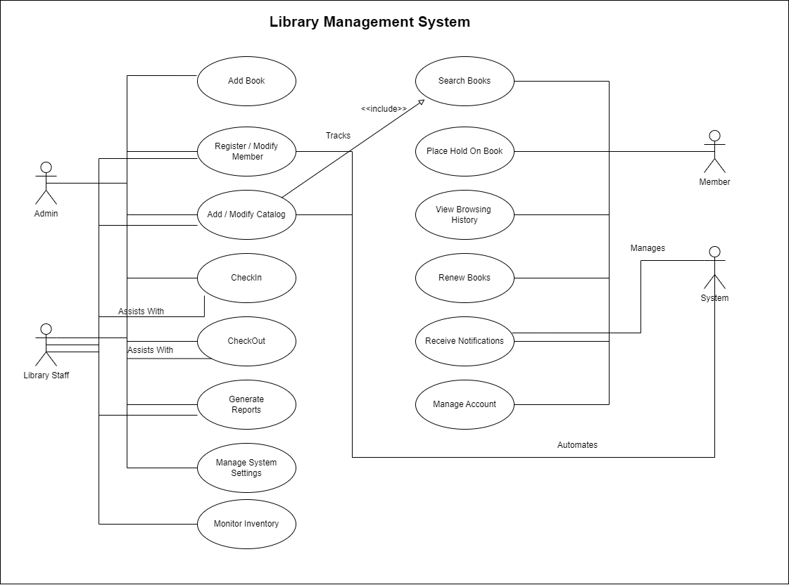
Use Case Diagram

Slide 4
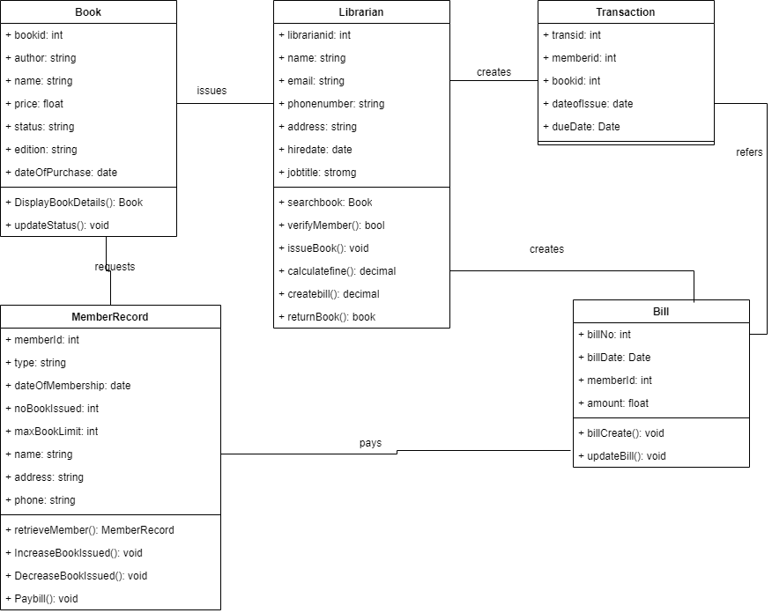
Class Diagram

Slide 5
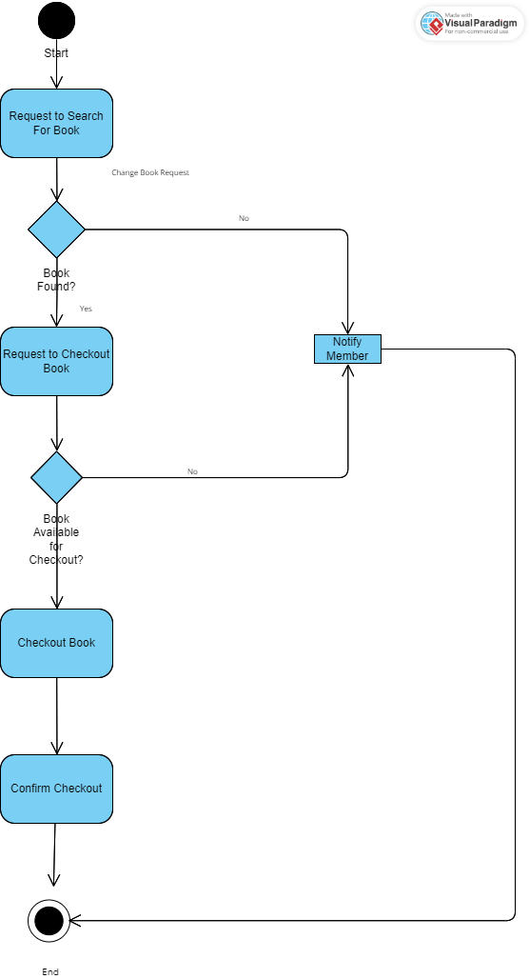
Activity Diagram

Slide 6
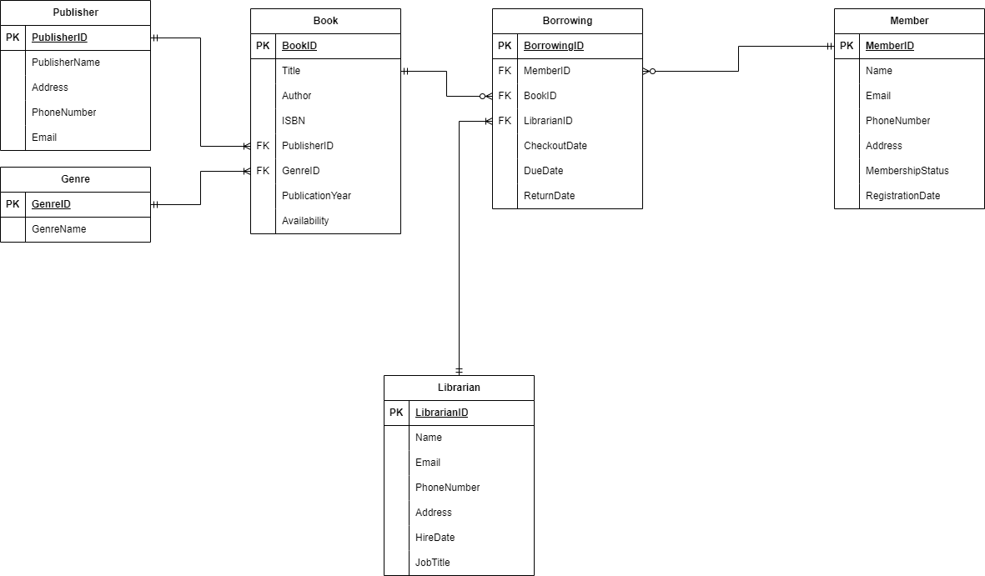
Database Implementation

Slide 7
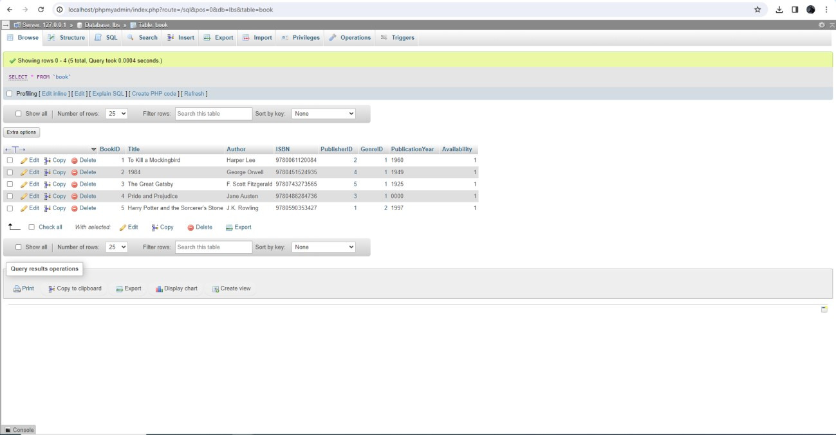
Data Population in Database

Slide 8
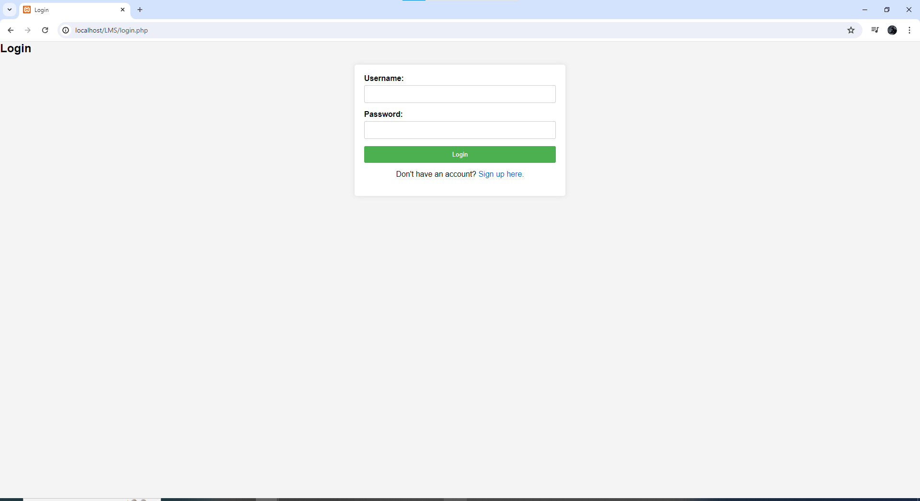
Web Interface-> Login Form

Slide 9
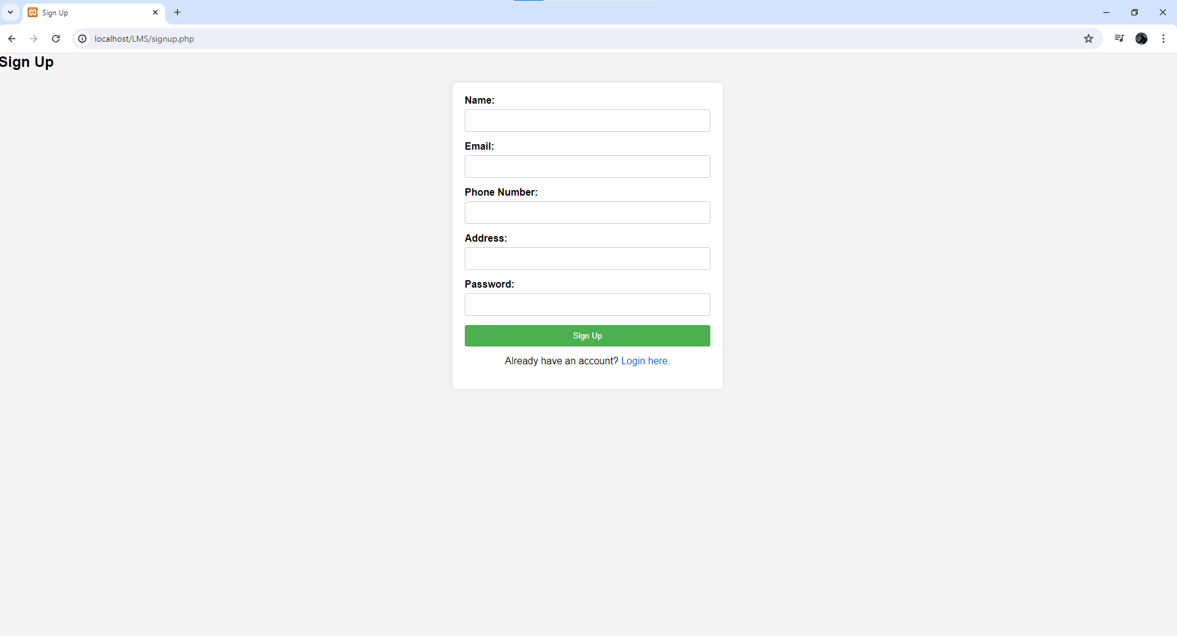
Web Interface
Sign Up

Slide 10
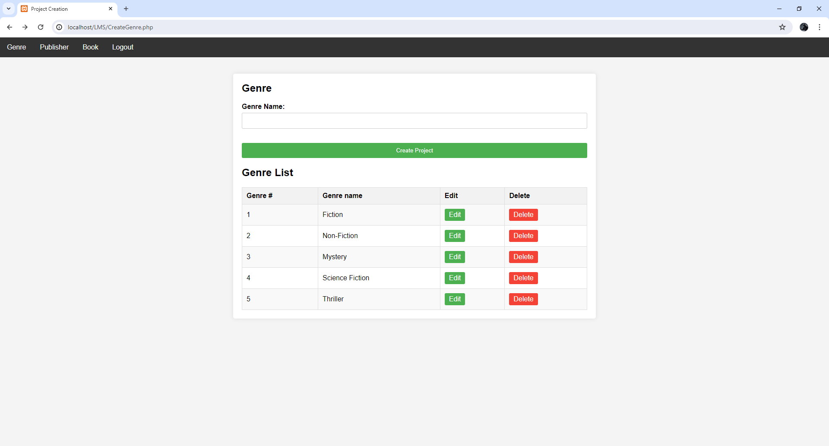
Admin Login

Slide 11
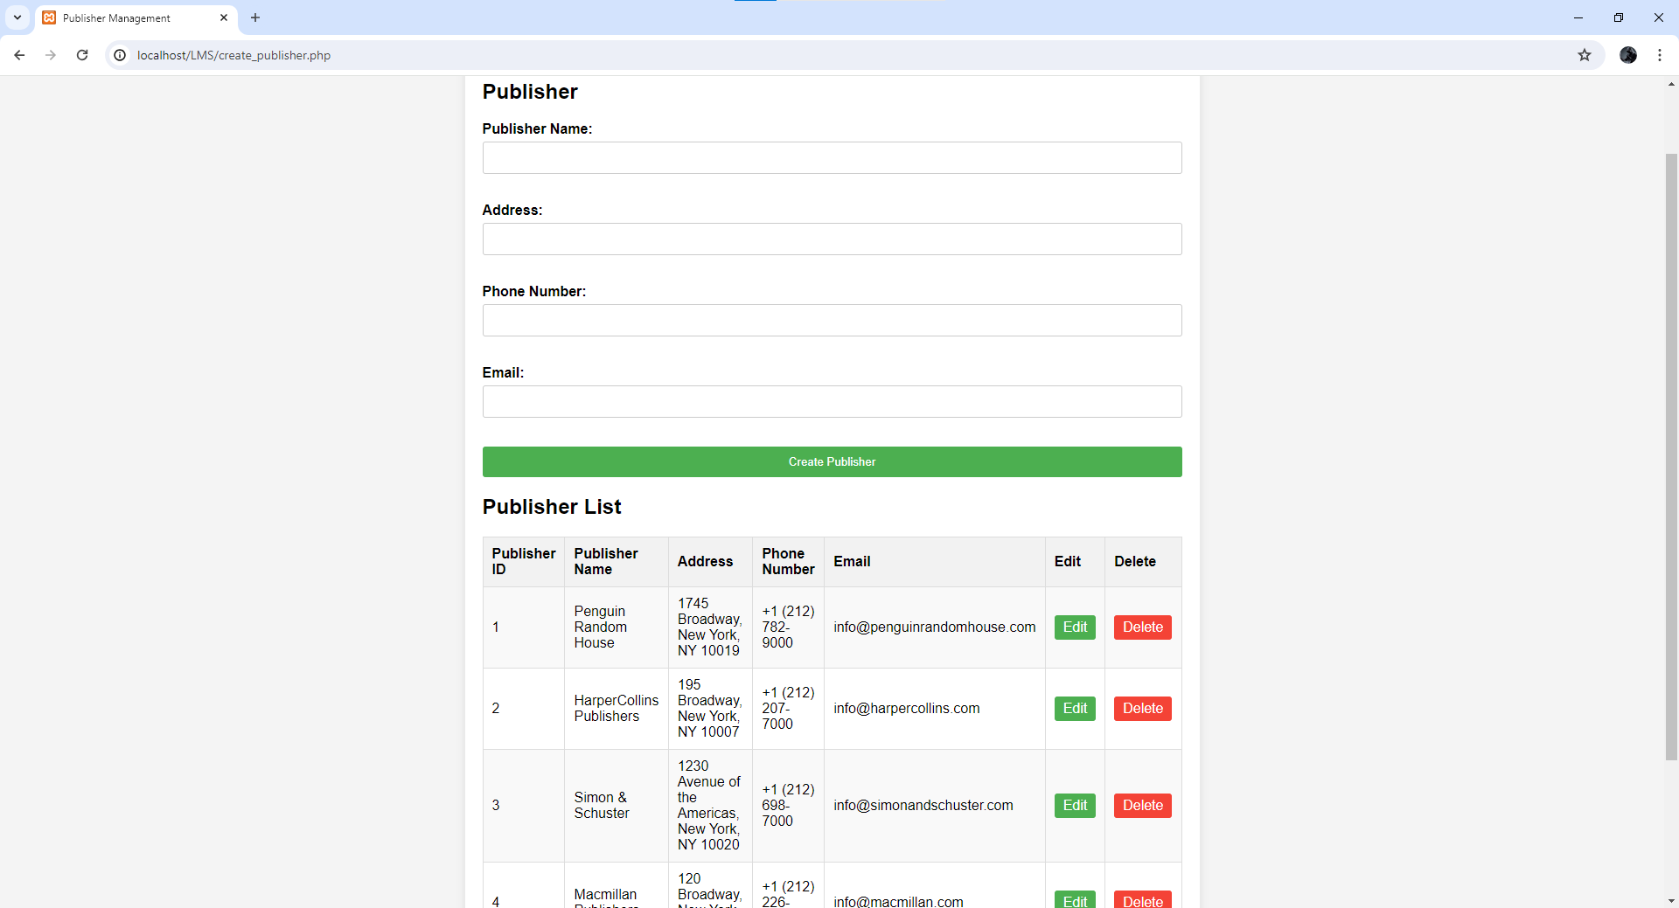
Publisher

Slide 12
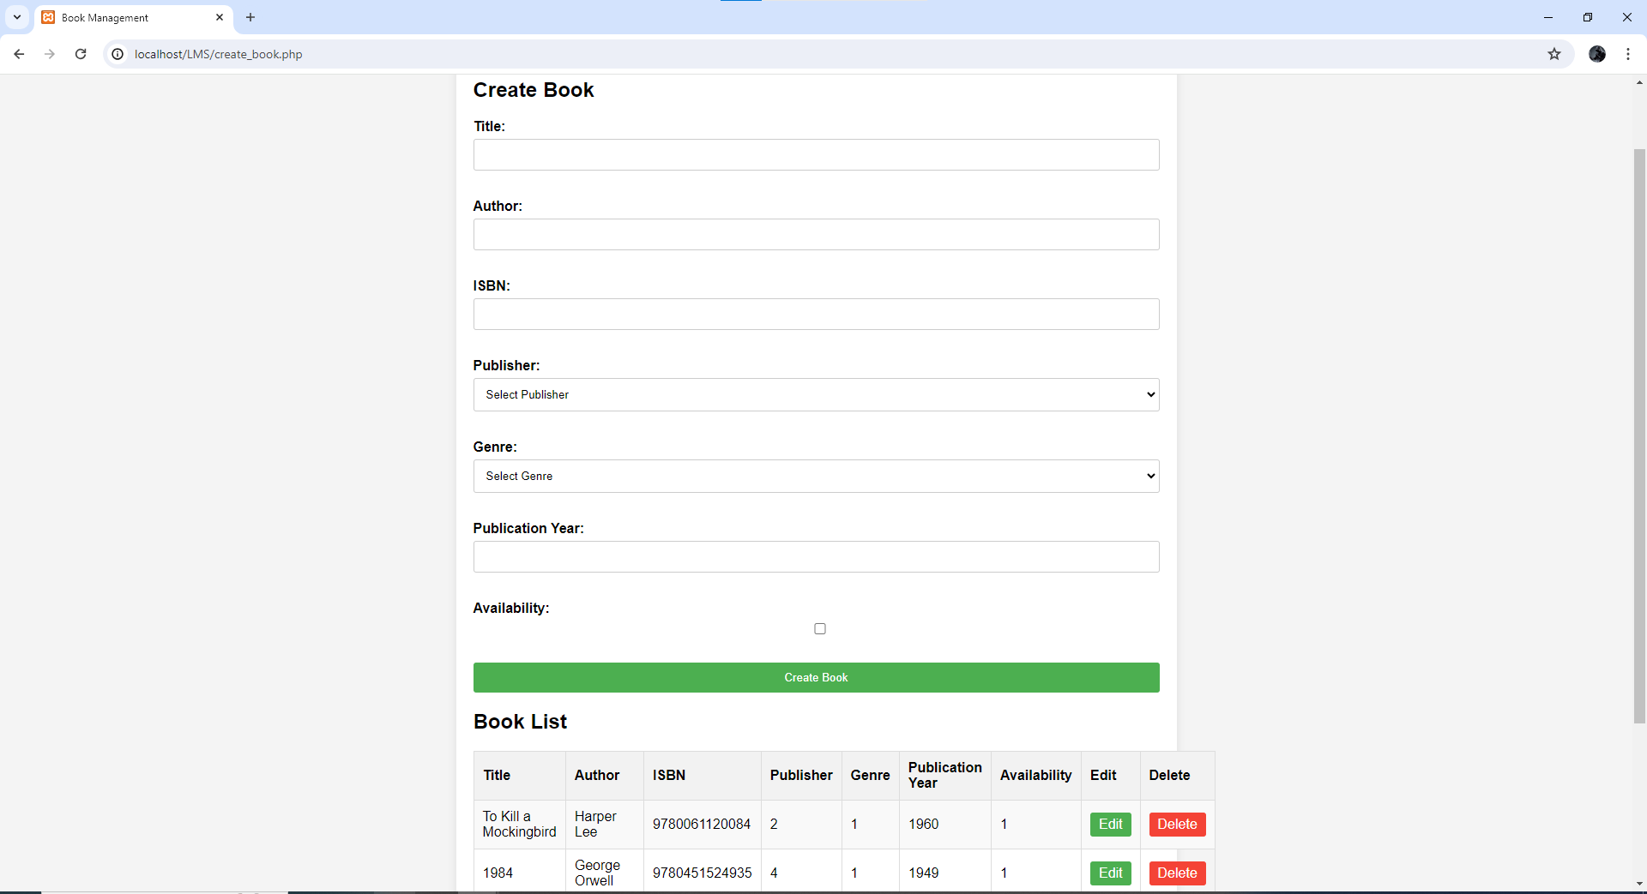
Add a book
Books

Slide 13
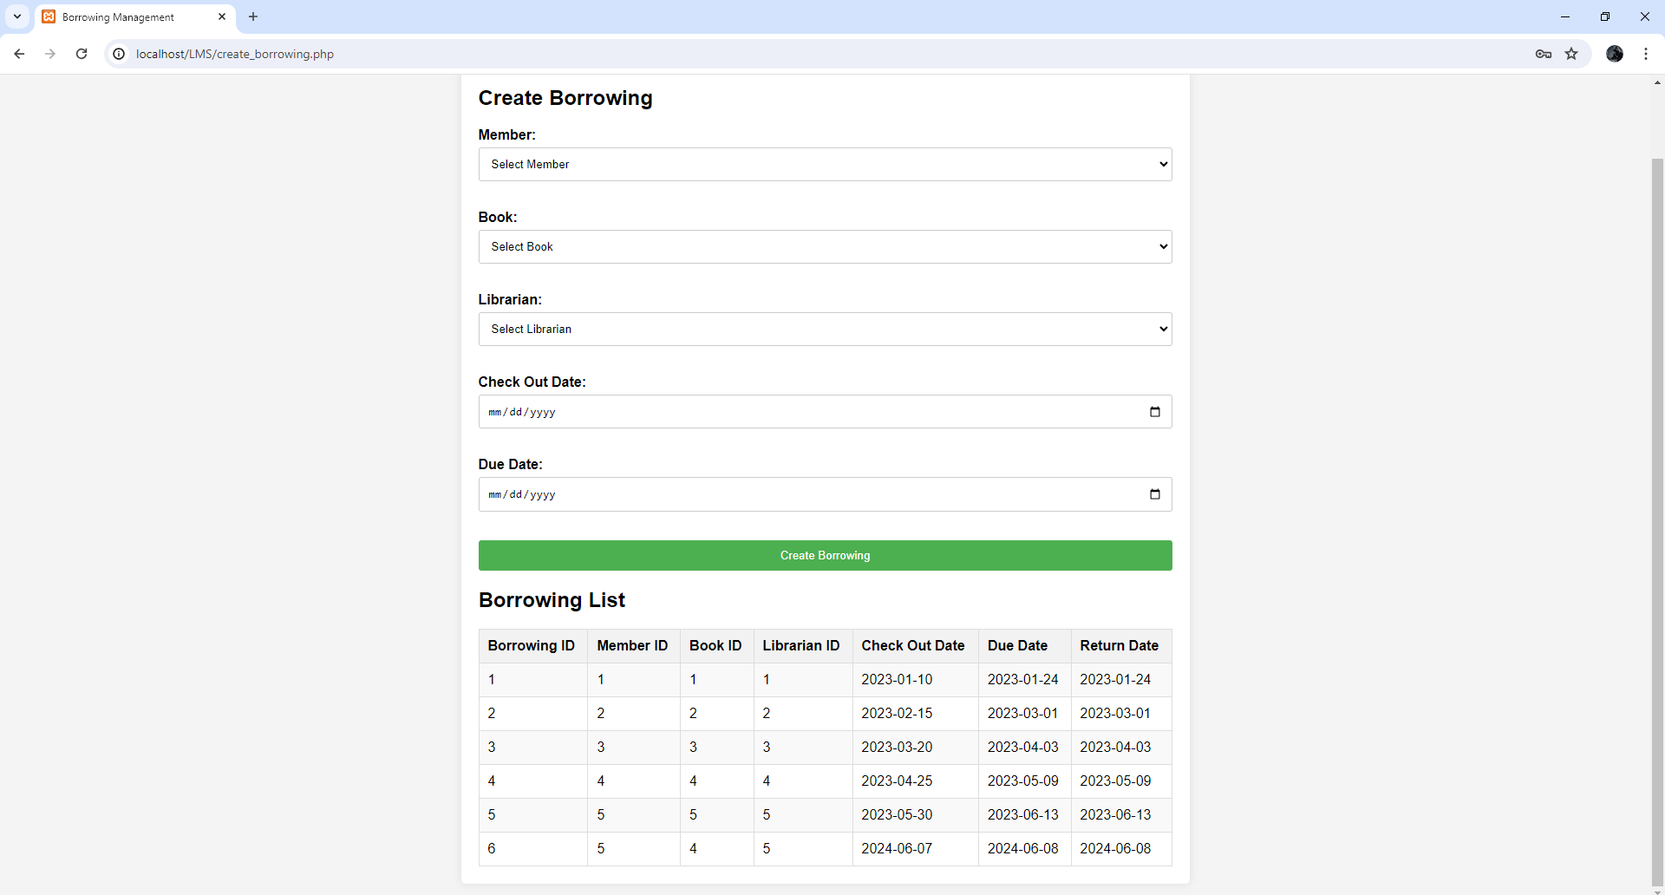
Member login->Borrow a Book

